Slide 1
EV Purchase Intent Prediction
Predictive Customer Modeling & Actionable Insights
MODEL PERFORMANCE
Winning XGBoost model delivers a 0.9427 ranking accuracy and 91% buyer detection rate on held-out data.

Slide 2
CORE BUSINESS QUESTION & STRATEGIC PURPOSE
THE CENTRAL QUESTION
Why are we predicting EV purchase intent?
Automotive manufacturers and marketers face massive inefficiency by targeting broad demographics rather than true high-propensity buyers.
Key Objective: Identify the exact combination of behavioral, psychological, and financial drivers that convert consideration into actual purchase action.
1. CAPITAL ALLOCATION
Optimize Marketing ROI
Shift spend away from non-predictive attributes like age or generic location toward high-conviction signals.
2. TARGETED INCENTIVES
Maximize incentives & Messaging Impact
Pair environmental messaging directly with incentives to unlock highest-converting audience segments.
STRATEGIC OUTCOME
Actionable Customer Intelligence
Replacing intuition with ML precision to accelerate EV adoption and maximize conversion.

Slide 3
Data set features.
BUSINESS OBJECTIVE
Determine which customer attributes reliably predict EV purchase likelihood.
Demographics & Geography
Age.
Gender.
Income.
City Type (Urban, Suburban, Rural).
Driving Habits & Infrastructure
Daily Commute distance.
Current Car Type.
# of cars owned.
Home charging available.
Availability of charging stations at home and work.
Psychological & Financial Factors
Self-reported Environmental Concern Level.
Range Anxiety Level. (Battery).
Subsidy Available.

Slide 4
PIPELINE EVALUATION
FEATURE SET COMPARISON
METHODOLOGY
CROSS-VALIDATION STRATEGY
The pipeline tested five candidate classifiers models across 5 independent data splits to confirm stability:
01. Logistic Regression
02. Random Forest
03. LightGBM
04. XGBoost
05. CatBoost
BASE DATASET
Silver Feature Set
Evaluated baseline models strictly utilizing cleaned base data features.
ENRICHED DATASET
Gold Feature Set
Evaluated architectures incorporating engineered interaction features.
EVALUATION RESULT
XGBoost Selected as Best Model Architecture
The Gold feature set consistently boosted predictive performance across all model families. Ultimately, XGBoost emerged as the top-performing architecture on the enriched data, selected as the best model for final tuning.

Slide 5

TUNING & VALIDATION
The XGBoost model underwent automated fine-tuning (150 iterations) on the enriched feature set, evaluated on a 20% held-out split.
RANKING ACCURACY (AUC-ROC)
0.9427
How well the model separates buyers from non-buyers (0–1 scale; 0.94 is near-perfect)
RECALL
91.10%
Catches 91% of actual buyers
SECONDARY METRICS
Precision: 55.33% (vs ~17.5% Base Rate)
F1: 0.6884
SEPARATION
KS: 0.7555
Kolmogorov-Smirnov Separation Statistic
BASELINE EVENT RATE & PRECISION LIFT
Base Event Rate (~17.5%): The tuned model's 55.33% Precision delivers a >3x efficiency lift over baseline for audience targeting.

Slide 6
FEATURE SIGNAL SUMMARY
ONLY 6 OF 13 FEATURES CONTAIN PREDICTIVE SIGNAL
TOP PREDICTIVE DRIVERS (INFORMATION VALUE)
CONVERSION IMPACT BREAKDOWN
ENV. CONCERN
IV 2.26
Environmental Concern (IV = 2.26)
Level 5 concern drives a 51.8% purchase rate versus 0.6% for Level 1.
SUBSIDY AVAIL.
IV 1.82
ANNUAL INCOME
IV 0.43
RANGE ANXIETY
IV 0.15
Subsidy Available (IV = 1.82)
Availability jumps conversion from 0.6% to 27.5%.
NON-PREDICTIVE FEATURES (IV < 0.01)
Negligible Signal Detected
The following features show no meaningful correlation with EV conversion rates:
Age, Gender ,City Type
Current Car Type, Charging Proximity
Annual Income (IV = 0.43)
Incomes over $127k yield a 35.7% purchase rate compared to 4.3% for under $51k.
Range Anxiety (IV = 0.15)
High/Medium anxiety drops conversion to 4.0% versus 18.9% for Low anxiety.

Slide 7
STRATEGIC INTERVENTIONS & OPTIMIZATION
SEGMENTATION
Targeting Strategy
Prioritize Environmental Concern Score (levels 4–5) as the primary segmentation axis for campaigns.
CONVERSION
Incentive Allocation
Focus incentives coverage to the motivated, price-sensitive mid-income band ($85k–$127k) to maximize conversion impact.
ENGAGEMENT
Range Anxiety Mitigation
Develop targeted messaging, test-drive programs, and fast-charger access to unlock the high/medium anxiety segment, addressing their 4.0% conversion gap against the 18.9% low-anxiety baseline.
RESOURCE OPTIMIZATION
Deprioritize demographic traits and charging proximity features in lead scoring models, as they provide no predictive signal.

Slide 8
APPENDIX

Slide 9
EXECUTION WORKFLOW
01
1. Data Preparation
1.eda_data_cleaning.ipynb processes raw data and generates fitted scaler_params.json and encoder_params.json.
02
2. Model Training
2.model_training.ipynb tunes the classifier and exports best_model.pkl alongside model_metadata.json.
03
3. Inference Evaluation
3.pipeline_model_evaluation.ipynb applies these saved artifacts to raw test data to output final probability predictions.
PRODUCTION ARTIFACTS
The pipeline relies on modular, saved processing rules. This ensures consistent, reproducible transformations on any new, unseen customer data entering the system.

Slide 10
APPENDIX — CONVERSION RATES BY CUSTOMER SEGMENT
668,665 training records · Overall EV purchase rate: 17.5% · Reference slide for Q&A
ENVIRONMENTAL CONCERN LEVEL
Level Buyers / Total Rate
─────────────────────────────────────
1 834 / 147,476 0.6%
2 2,889 / 135,133 2.1%
3 14,126 / 127,351 11.1%
4 32,467 / 130,469 24.9%
5 66,463 / 128,236 51.8%
Range: 0.6% to 51.8% (86x gap)
Verdict: dominant predictor.
Each level up roughly doubles
the purchase probability.
ANNUAL INCOME
Bracket Buyers / Total Rate
────────────────────────────────────────
Under $51k 3,269 / 75,892 4.3%
$51k to $85k 32,013 / 260,416 12.3%
$85k to $127k 64,523 / 284,860 22.7%
Over $127k 16,974 / 47,497 35.7%
Range: 4.3% to 35.7%
Verdict: strong predictor.
AGE — NO SIGNAL
Age Group Buyers / Total Rate
──────────────────────────────────────
18 to 25 1,917 / 13,264 14.5%
26 to 35 26,403 / 145,995 18.1%
36 to 45 25,060 / 149,378 16.8%
46 to 55 29,702 / 156,512 19.0%
56 to 65 24,027 / 144,548 16.6%
66 plus 9,670 / 58,968 16.4%
Range: 14.5% to 19.0% (flat)
Verdict: age predicts nothing.
SUBSIDY AVAILABLE
Subsidy Buyers / Total Rate
──────────────────────────────────────
No 1,432 / 248,756 0.6%
Yes 115,347 / 419,909 27.5%
Without subsidy: near-zero uptake.
Verdict: decisive on/off switch.
GENDER — NO SIGNAL
Gender Buyers / Total Rate
──────────────────────────────────────
Female 52,480 / 295,427 17.8%
Male 63,381 / 367,954 17.2%
Other 918 / 5,284 17.4%
Range: 17.2% to 17.8% (flat)
Verdict: gender is irrelevant.

Slide 11
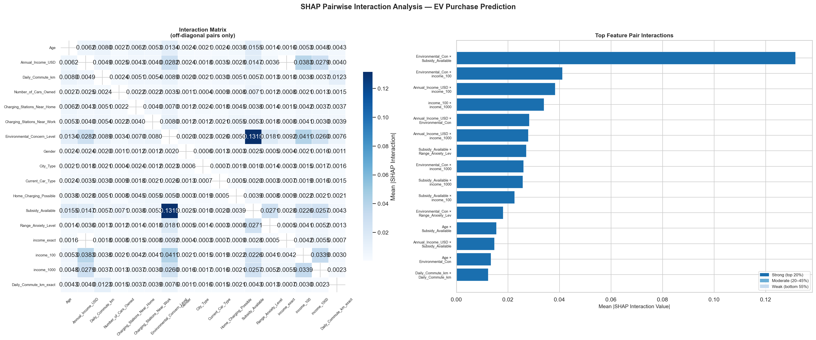

Slide 12
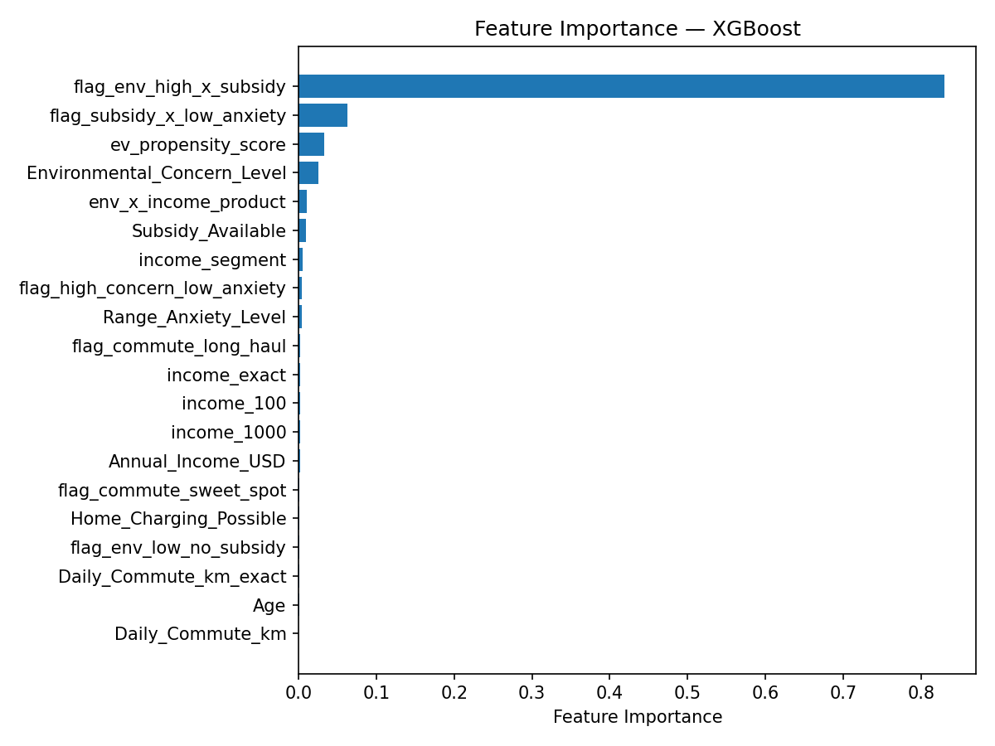

Slide 13
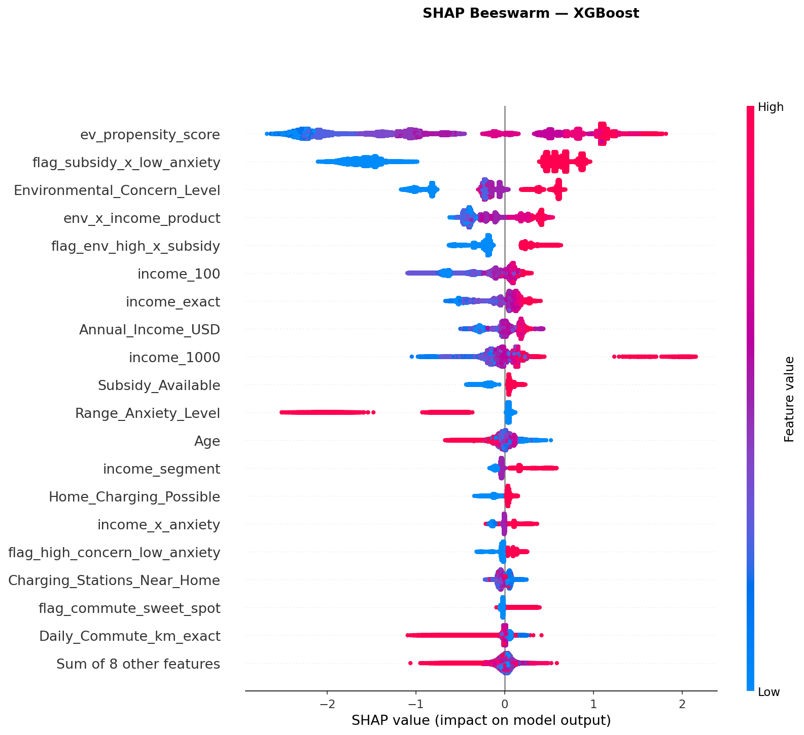

Slide 14
